Slide 1
Community Service Project
MENTOR TRAINING - DAY 2

Slide 2
Share any 1 objective of Community Service Project?
How many hours of engagement?
How many credits are allotted?
What does SDG stand for?
AP stands at __th rank in Multi-dimensional poverty index.

Slide 3
Recap…
3 recommendations given by NITI Ayog
Producing more knowledge and data
Demographic dividend
Addressing Skill Gap
Why do we need a mentor?
Mention any 2 roles of a mentor in CSP
Teacher Advisor
Liaison Role Model
Coach Confidante

Slide 4
Recap…
Intro: Community Service Project, Objectives and Expectations
Intro: UN SDG’s and SDG agenda 2030
Alignment of SDG’s and Localisation of SDG’s Overview
Intro: NFHS Data, Present reflections on the state of AP & it’s Socio Economic Survey
Role of Youth & Mentors in achieving the objectives of Community development program

Slide 5
Introduction to Design Thinking

Slide 6
Norms
1 min
Participate
Be Hands-on
…!!!

Slide 7
What Am I Talking About
1 min

Slide 8
The Water Bottle
7 min
Draw a Bottle
Describe the Bottle

Slide 9
Who Needs the Better Bottle
6 min
Old Women
Carry their bottle and bag everywhere
Cyclists
Need energy drinks when
riding their cycle
Office Goers
Like drinking hot coffee
when working

Slide 10
The Better Bottle
2 min
Understand the User
Upgrade the Bottle
Explain your New Bottle

Slide 11
What Did We Do
2 min
DESIGN THINKING
Design thinking is both a process and an ideology (way of thinking) that seeks to solve complex problems in a user-centric way. It focuses on achieving practical results and solutions that are:
Technically feasible: They can be developed into functional products or processes;
Economically viable: The business can afford to implement them;
Desirable for the user: They meet a real human need.

Slide 12
Design Thinking Framework

Slide 13
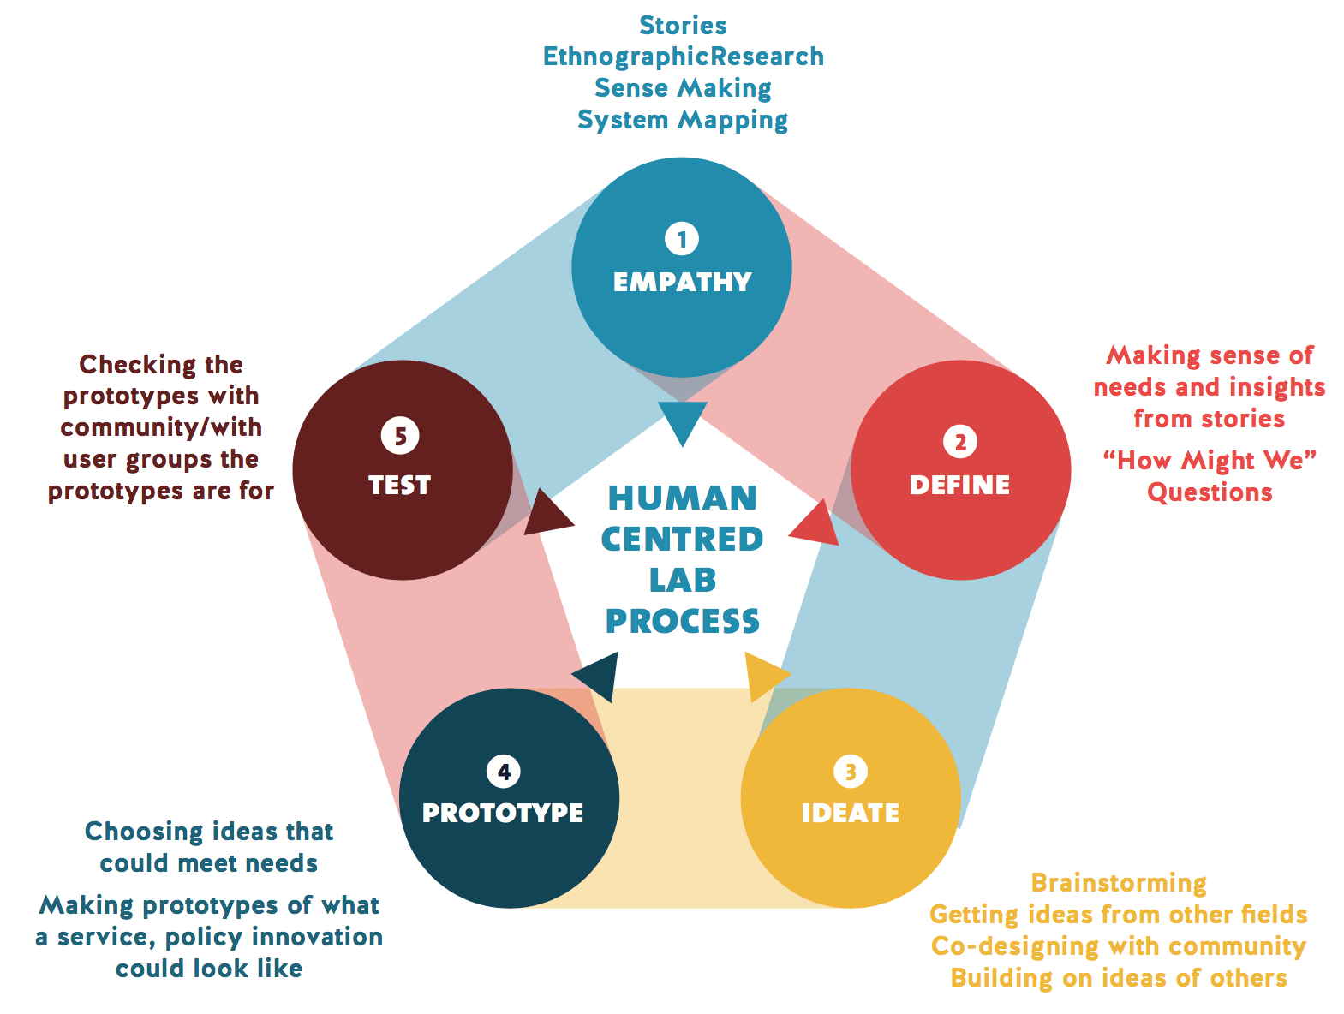
5 min

Slide 14
Key Principles
10 min
User centricity or Empathy:
Did we empathize with the Users while designing the bottle?
(Rate 1-5 on chat)
Collaboration:
Did we collaborate with the Users while designing the bottle?
(Rate 1-5 on chat)
Ideation:
Did we ideate while designing the bottle?
(Rate 1-5 on chat)
Experimentation and iteration:
Did we test and improve the design of the bottle?
(Rate 1-5 on chat)
Bias towards action:
Did we show bias towards actions while designing the bottle?
(Rate 1-5 on chat)

Slide 15
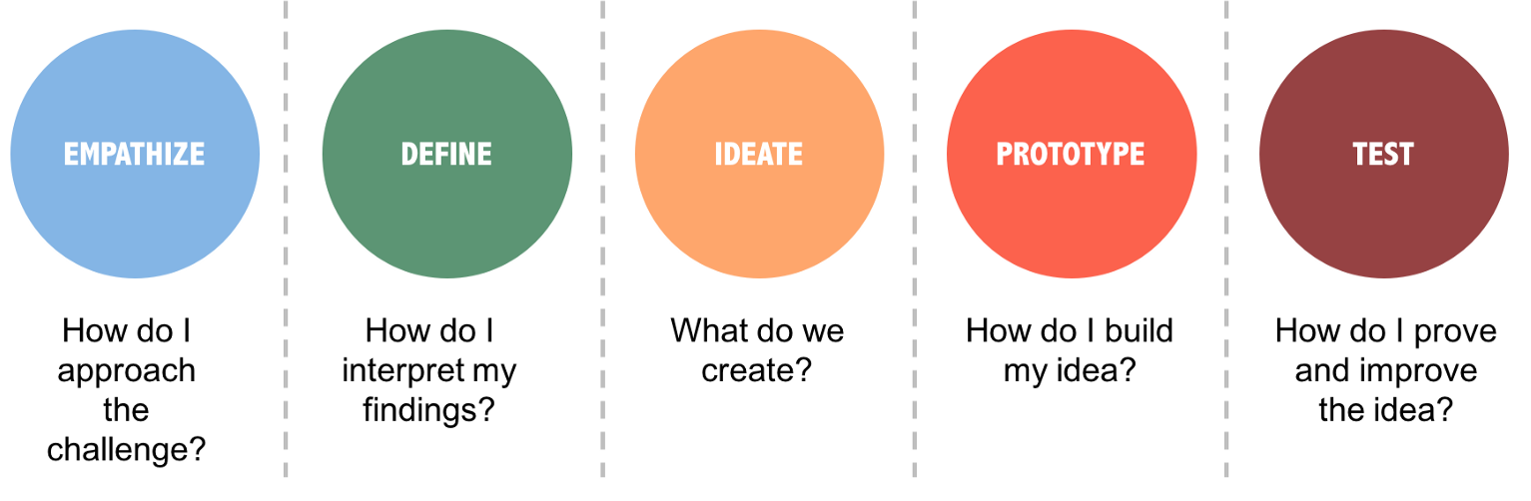
Design Thinking in everyday life
5 min
Some students are bored in class, unable to connect to the subject
How might we make the class engaging for students to develop a passion towards this subject?

Slide 16
Design Thinking in everyday life
5 min
Does your way of applying Design Thinking make good use of the 5 Design Thinking Principles?
Which principle did you use?
Which principle didn’t you use?
How can you improve your approach?
User centricity or Empathy
Ideation
Experimentation and iteration
Bias towards action
Collaboration

Slide 17
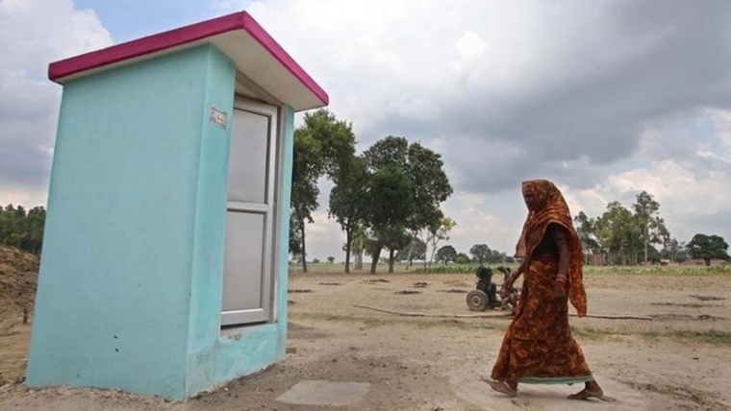
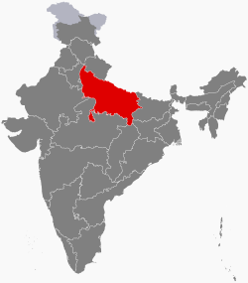
Design Thinking Principles in CDP Program
5 min
Do you think this way of thinking is useful for the Youth Participants within the CDP Program?
PROBLEM
Open defecation causing a lot of illnesses in Uttar Pradesh State, India.
IDEA
Build state funded toilets for every household
IMPLEMENT
Toilets built! Yippiee!
External study:
Only 50% of toilets are being used!!
What did we miss!

Slide 18
BREAK
15 MINS

Slide 19
QUICK RECAP
5 min

Slide 20
What did we do?
5 steps of design thinking are?
How is it useful for the community development program?

Slide 21
5 min

Slide 22
Problem Identification and framing a research question

Slide 23
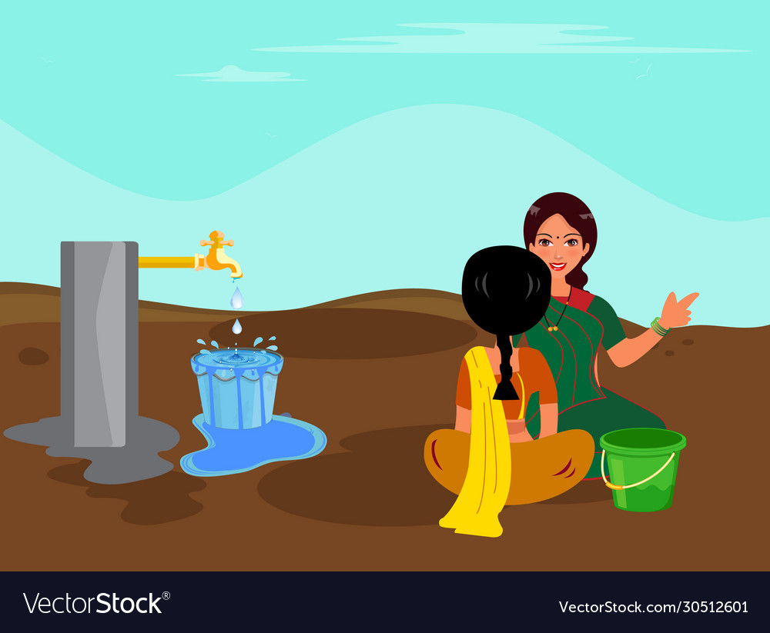
What is a Problem?
Any issue or challenge that affects the community is a problem

Slide 24
How to identify a problem?
Observation
Interviews
Group discussions
Document reviews
Experiences

Slide 25
What is the right problem
Giving scores of 1-5
Problem | Urgency How badly is it affecting the environment ? | Knowledge How much can you understand about this problem ? | Ability How confident are you to solve the problem ? | Interest How interested are you to solve the problem ? | Total Score Higher the score, more it should be solved
Problem 1
Problem 2
Problem 3

Slide 26
Problem | Urgency How badly is it affecting the environment ? | Knowledge How much can you understand about this problem ? | Ability How confident are you to solve the problem ? | Interest How interested are you to solve the problem ? | Total Score Higher the score, more it should be solved
Garbage is not being collected | 4 | 3 | 3 | 2 | 12
There is no drinking water facility in the staff room | 3 | 4 | 4 | 3 | 14
No wifi in college campus | 2 | 4 | 2 | 5 | 13

Slide 27
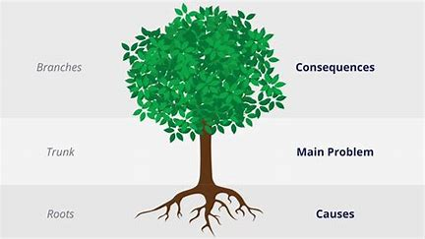
Problem Tree Analysis
Problem tree helps you map the causes and effects of a problem and gives a better understanding of the current situation.

Slide 28
Framing a Problem Statement
Causes+Effects+Users Affected= Problem Statement
Example: There is a water shortage in the village as there is no proper drainage system and the children of the village are falling sick and missing school
There is a water shortage in the village as there is no proper drainage system and the children of the village are falling sick and missing school

Slide 29
Let’s check our understanding
Because of lack of data, not every ration shop is getting the required load of sugar and the members of community are spending extra amount on sugar.

Slide 30
Because of lack of data (Cause), not every ration shop is getting the required load of sugar (effect) and the members of community are spending extra amount on sugar (Main problem/user affects).

Slide 31
Research Question
A question that addresses an issue or a problem which through analysis and interpretation of data, is answered in study’s conclusion. It is important as it sets a foundation for research

Slide 32
Problem Statement and Research Question…?
Problem statement merely explains the context of the problem with its causes and effects
Example: Because of lack of data, not every ration shop is getting the required load of sugar and the members of community are spending extra amount on sugar.
However, Research question will help you research about the problem and come to a conclusion. It is the basis for setting hypothesis and by the end of the research you either prove or disprove the hypothesis.
Example: Would having sufficient data of the districts ration shops help in supply of essentials?
Working Hypothesis:Lack of data is making the consumers spend more
Null Hypothesis: Lack of data is not contributing.

Slide 33
How should it be framed
Focus on one problem
Should be researchable (through primary or secondary data)
Feasible as per time frame and practical constraints
Specific (every part should get an answer)

Slide 34
Summary
Why’s of the Program?
(Majorly Context Setting/Awareness)
How’s of the Program?
(Tools, Applications & Resources)
#1
CSP Introduction : What is the Program about?, How is it important and useful and How do we execute the program on ground
#5
Design thinking as a Tool for Identification of Problem
#2
SDG’s Session : Why is it Important for a state or an individual to align our development goals to SDG’s in alignment to CSP
#6
Community Based Participatory Research - How do we make community as prime focus, how do we engage them as one of the stake holder. Would be applicable during the implementation of Project
#3
Why Does Govt Publish Reports? How can we use these reports as a knowledge resource to build a project & to understand where do we currently stand & Understand scope of Intervention
#7
Identification of Problem, Problem Tree Process - Understanding in depth of a Problem and its causes
#4
Role of Youth , Mentor & Socially Responsible Citizen?
#3
Reports as a tool to understand data. - Socio economic surveys, Niti Aayog Report, NFHS data etc.

Slide 35
BREAK
60 MINS

Slide 36
Role of a student
Facilitator role
Conduct programs with Governmental agencies, Non-Governmental agencies or faculties of their college
Health.
Faculty as Resource Persons.
Close association with Non-Governmental Organizations like Lions Club, Rotary Club, etc or with any NGO actively working in that habitation
Governmental Departments.
District Administration could be roped in for the successfuL deployment of the programme.
Students will be expected to daily log their work and submit a project report at the end of the project
Students will be given a curriculum which will be self paced and guide with step by step chapters on how to conduct this project

Slide 37
Role of a Master Trainer
Master Trainer Training sessions to understand the project and it's outcomes
Train mentors
Role of facilitators and guide mentors on the further execution of the project
Successful delivery of the project
POC for external team and mentors
Motivator
Smooth functioning of the project and problem solve any issues

Slide 38
Role of a Mentor
Mentor Trainer Training sessions to understand the project and it's outcomes
7 days with 4 online and 3 offline sessions
Guide
Encourage
POC between the master tainers, department and the students
Smooth functioning of the project and problem solve any issues
Resource Persons to the students
There will be only internal evaluation for this internship. Each faculty member/ mentor is to be assigned with 10 to 15 students depending upon availability of the faculty members/mentors
The faculty member will act as a faculty-mentor for the group and is in-charge for the learning activities of the students and also for the comprehensive and continuous assessment of the students.
The mentor will grade the student project reports

Slide 39
Role of a Mentor
Mentor Trainer Training sessions to understand the project and it's outcomes
7 days with 4 online and 3 offline sessions
Guide
Encourage
POC between the master tainers, department and the students
Smooth functioning of the project and problem solve any issues
Resource Persons to the students
There will be only internal evaluation for this internship. Each faculty member/ mentor is to be assigned with 10 to 15 students depending upon availability of the faculty members/mentors
The faculty member will act as a faculty-mentor for the group and is in-charge for the learning activities of the students and also for the comprehensive and continuous assessment of the students.
The mentor will grade the student project reports

Slide 40
Weightage
Project Log 20%
Project Implementation 30%
Project report 25%,
Presentation 25%
The individual student’s effort and commitment.
The originality and quality of the work produced by the individual student.
The student’s integration and co-operation with the work assigned.
The completeness of the logbook.

Slide 41
The assessment for the Community Service Project implementation shall
include the following components and based on the entries of Project Log and
Project Report:
a. Orientation to the community development
b. Conducting a baseline assessment of development needs
c. Number and Quality of Awareness Programmes organised on beneficiary programmes and improvement in quality of life, environment and social consciousness, motivation and leadership, personality development, etc.
d. Number and Quality of Intervention Programmes (Prevention or promotion programs that aim to promote behavioural change in defined community contexts to address social problems) organised.
e. Follow-up Programmes suggested (Referral Services, Bringing Community
Participation)
f. Developing short and mid-term action plans in consultation with local leadership and local government officers.

Slide 42
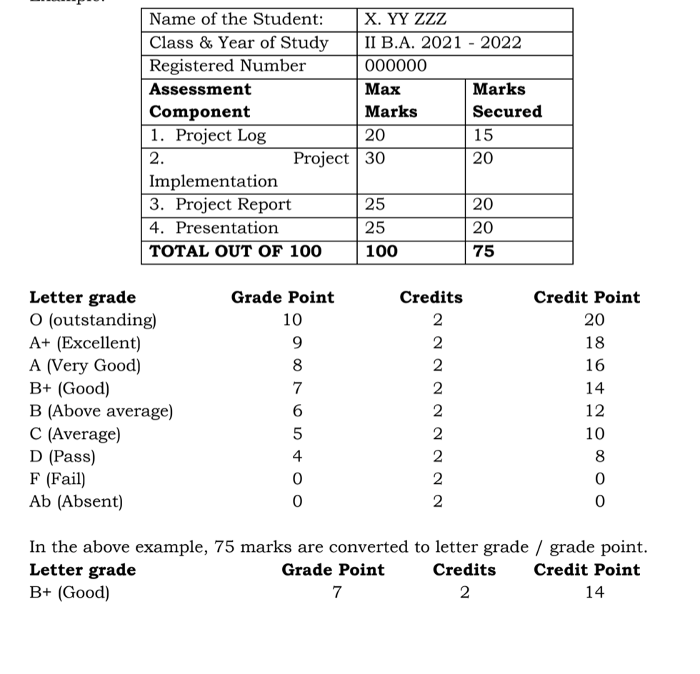
The Project Report shall be prepared as per the guidelines given in the Model
Project Report.
The Project Presentation is to be made by the student after he/she reports
back to the College. The components for assessment are –
a. assessing the involvement in the project
b. presentation skills
c. final outcome of the project as evinced by the student.
Example:

Slide 43
BREAK
15 MINS

Slide 44
8 week split
Socio-Economic Survey of the Village/Habitation (Two weeks): A group of students under the guidance of faculty mentors conduct a Socioeconomic Survey of the Village/habitation. They will interact with people to acquire basic knowledge on the project chosen for study and conduct the survey using a structured questionnaire.
Community awareness campaign (one week): The students group takes up community awareness campaigns based on the above survey conducted by identifying the problems or vulnerable issues. They may also conduct house to house campaign on socially relevant theme. Ex: Government welfare programs, health care, consumer protection, food adulteration, digital transactions, information sources, etc.
Main Project (4 weeks): A group of students choose a topic related to their subject area and conduct a Project which includes, Data collection, interviews, internship in any select unit or department.
Report preparation (one week): The student should submit a project report duly signed by the mentor.

Slide 45
QnA
30 MINS

Slide 46
Points to be noted:
The Department will Communicate about the Next Schedule of training.
At the end of training sessions, all supporting materials will be shared all at once.
We have taken note of all of your concerns and questions, and we will talk to the department and get answers.
Additionally, we will work with the department to guarantee that this programme is executed without difficulty.

Slide 47
How would you Rate our Sessions Overall 1(Low) - 5(High)?
> were they useful?
> Learnt something new?
: Type in the chat box

Slide 48
See you all again for the next session :)

